Slide 1

STATE OF MARYLAND AMENDMENTS TO THE
2024 MODEL CODES
State of Maryland
Fire Prevention Code
Ken Bush
Chief Fire Protection Engineer
Office of the Maryland State Fire Marshal
Pikesville, MD
Rev: 3/12/2024
Notes:
About me: Been with the State about 15 years, 11 years in SRO, and coming up on 4 in HQ
Before that I spent a few years in consulting designing sprinkler and fire alarm systems, reviewing contract drawings and shops, and doing inspections and testing
I’d like to know a little about you: Any plan reviewers? Any designers/installers/contractors? how many inspectors?
I want to say, thank you for what you do.
I do mostly plan review, and it’s in 2 dimensions. You can only put so much information on a piece of paper, a set of drawings
But inspectors have to work in 3 dimensions. It’s a lot of information that you’re taking in when you’re on a jobsite, and it’s not easy.
I really just want to thank you for doing what you do.
How many of you are happy that you got into fire safety?
I kind of stumbled into it, I thought that I wanted to be an architect
Then I found out how many architects there are- and how hard it is to get a job
So I found my way into fire protection, and I’m happy that I did.
I don’t know many people in this industry that regret it.
I’m going to talk today about the 2025 State Fire Prevention Code, adopted June 23, 2025
Errata No. 1 was issued on July 15, so make sure that your copy includes that at the front
We got a new code! How about that? It’s been a long time coming.
As most of you are aware, we missed a code cycle for the first time, and we are going from the 2018 to the 2024 editions of the codes
Much needed update, and many important changes are now a part of the code
I’m sure that most of you here know, but I wanted to give you a quick review on the Code Update Committee
Every cycle about 40 people from all over the State and various jurisdictions work through the new codes
It’s a democratic process led by the Chief Engineer from the State Fire Marshal’s Office
I’ve been lucky to be on that committee every cycle since the 2012 cycle
Every cycle we go through the changes to NFPA 1 and NFPA 101 and decide what to do with them
Most of the time we keep the changes, but other times we change them a little bit, and then sometimes we decide that they are not for us
So today that is what I’d like to talk about

Slide 2
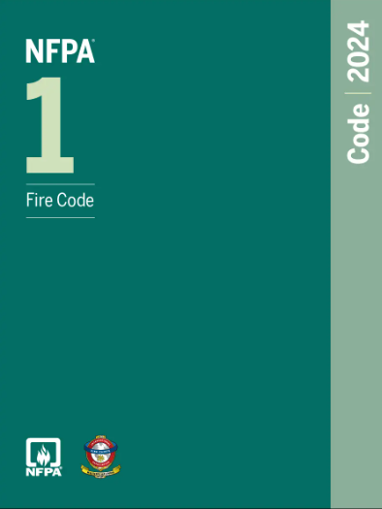
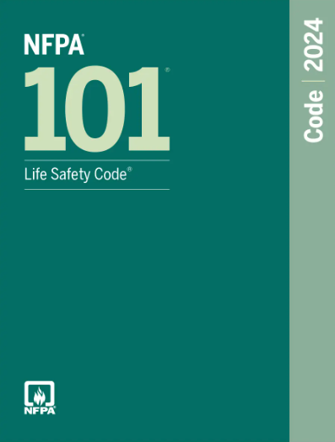
State of Maryland
Adopted June 23, 2025, Errata #1, July 15, 2025
NFPA 1 and NFPA 101, 2024 editions incorporated
  95 Amendments to NFPA 1
    38 are new
  70 Amendments to NFPA 101
    33 are new
  Total of 71 new amendments
Fire Prevention Code
Notes:
My plan is to cover only the State’s amendments to the model codes
To be clear, we would need a lot of time to go through all of the changes between the 2018 and 2024 editions of the codes
There are many, many important changes covering an array of issues that have occurred since the 2018 edition
And this of course is not even the tip of the iceberg if you think about changes to the referenced standards: NFPA 13 and 72 are now updated to the 2022 editions- going from the 2016 editions
But the goal today is just to cover Maryland’s amendments to the model codes, and of those, we are just going to be looking at the ones that are new to this update
So we’re going to do all of NFPA 101, and if there’s time I have about 20 from NFPA 1 to cover
So let’s get started

Slide 3
Maryland SFPC
Amendment C
  3.3.70.1 One- and Two-Family Dwelling Unit. A building that contains not more than two dwelling units, each dwelling unit occupied by members of a single family with not more than three five outsiders, if any, accommodated in rented rooms.
  2018 language
NFPA 101
Notes:
Here we have a definition for one- and two-family dwelling unit that NFPA changed in the 2021 edition
NFPA added the number of outsiders and the language “if any, accommodated in rented rooms,”
They made their change to match what they have always done in Chapter 6 on Classification of Occupancies
So we made our update to match what the State has always done in Chapter 6
While this is technically a new change, the concept is the same
Anyone know why we delete the “accommodated in rented rooms” part?
it is to make clear that it doesn’t matter whether you rent the rooms or live there for free
The way we approach it is the same

Slide 4
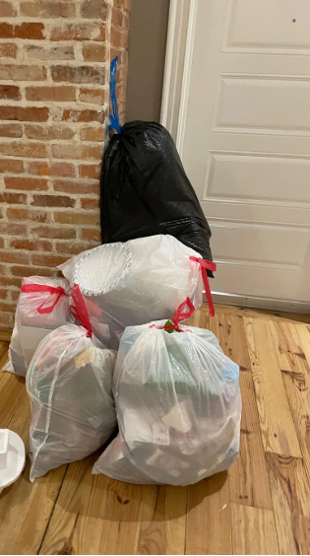

Maryland SFPC
Amendment L
  Amend Subsection 7.1.10 to add the following paragraph:
    7.1.10.3 Trash or recyclable materials awaiting scheduled
    collection shall not be placed in exits, exit access corridors,
    or on egress balconies.
NFPA 101
Notes:
Amendment L adds a paragraph to Section 7.1.10 on Means of Egress Reliability
This is an added paragraph that prohibits valet trash
Has anyone seen this in your travels or in your jurisdictions?
Did it look like this? Or this?

Slide 5

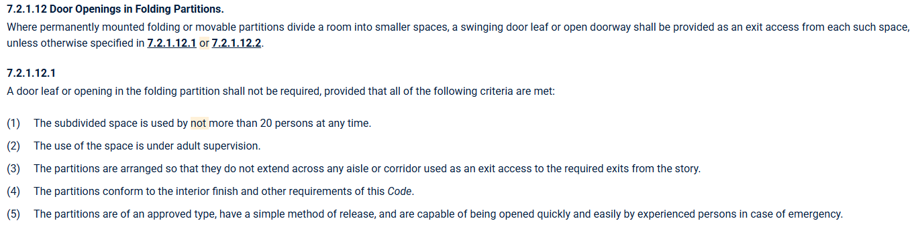
Maryland SFPC
Amendments P and Q
  Delete 7.2.1.12.1 and its reference in 7.2.1.12
NFPA 101
Notes:
These are in regard to means of egress in rooms having folding partitions
Kind of a strange section, because it requires a door in a folding partition unless you meet one of these provisions
Section 7.2.1.12.2 basically says you don’t need the door in the partition if you meet means of egress for the connected rooms without the door
All of this sounded very cumbersome, so the committee deleted all of it
The result is that you need to meet means of egress for each side when the partition is closed, but you may use door in the partition if needed for exit access
Much simpler

Slide 6
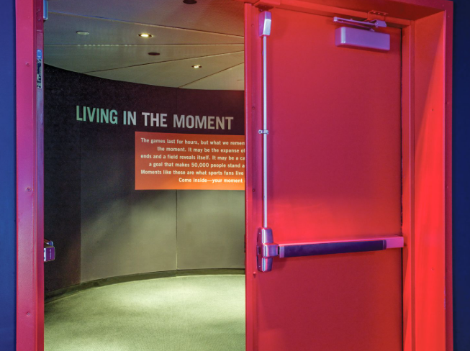
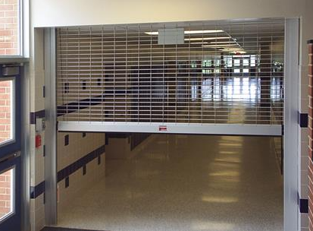
Maryland SFPC
Amendment R
  7.2.1.14.1 Where required by the AHJ or Chapters 11 through 43, the following door assemblies shall be inspected and tested not less than annually...
  7.2.1.15.1 Where required by the AHJ or Chapters 11 through 43, grille assemblies shall be inspected and tested not less than annually…
NFPA 101
Notes:
Amendment R is another Chapter 7 change
The requirements for inspection of door assemblies are not new
They require certain kinds of doors to be inspected: doors w/ panic hardware, doors in exit enclosures, doors that are electrically locked, and doors w/ special locking arrangements (delayed egress, sensor release)
They show up in Chapter 12 for assembly occupancies
We added “the AHJ or” which allows the AHJ to enforce the requirements in other occupancies
The grille assembly inspection requirements are new to the 2021 edition
Right now, no occupancy chapter references these
With the amendment they can be applied as required by the AHJ

Slide 7
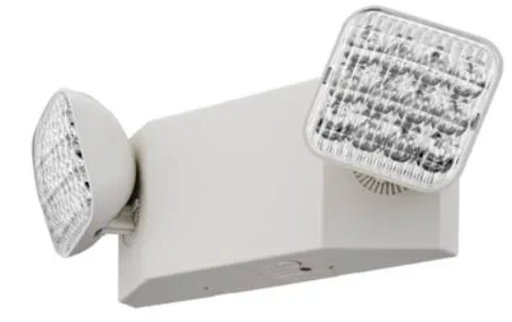
Maryland SFPC
Amendment S
  For the purposes of 7.9.1.1, exit access shall include, but not be limited to only designated stairs, aisles, corridors, ramps, escalators, and passageways leading to an exit. For the purposes of 7.9.1.1,
  exit discharge shall include, but not be limited to only designated stairs, ramps, aisles, walkways, and escalators leading to a public way.
  2018 amendment changed “only” in the first sentence, but not the second
  Allows authorities some leeway for requiring emergency lighting in elements that are part of the exit discharge
NFPA 101
Notes:
This is an amendment for where emergency lighting is required
Before, we replaced “only” just in the first sentence on exit access
We’ve always changed that first sentence
In this cycle we added it to the second sentence as well
This gives the AHJ discretion over emergency lighting locations
Anyone think of a situation where you might use this amendment?
You might use this for exits that are not actually required exits

Slide 8
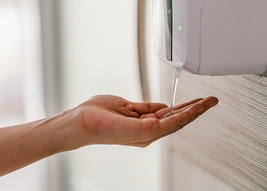
Maryland SFPC
Amendment T
  8.7.3.3 Alcohol-Based Hand-Rub (ABHR) Dispensers. Where permitted by Chapters 11 through 43, ABHR dispensers shall be permitted provided they meet all of the criteria in 8.7.3.3. through 8.7.3.3.5, unless otherwise permitted by the AHJ.
NFPA 101
Notes:
Moving on the Chapter 8
This amendment is regarding ABHR dispensers
There is are a bunch of criteria including provisions for hand sanitizer:
Dispenser capacity, dispenser location, 48 in horizontal spacing,
Even operation and testing, spill containment and maintenance requirements
The amendment left all of it in place, and also left it up to the AHJ if they felt that some leeway was reasonable

Slide 9
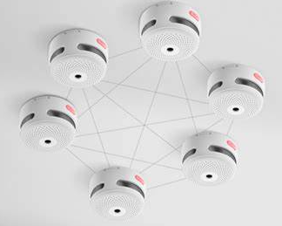
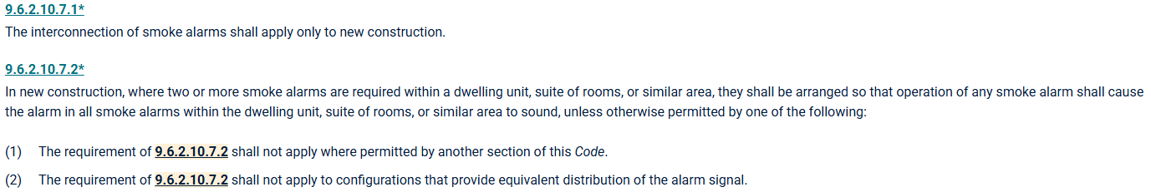
Maryland SFPC
Amendment W
  Delete 9.6.2.10.7, 9.6.2.10.7.1 and 9.6.2.10.7.2
    Requirements for interconnection of smoke alarms deleted
NFPA 101
Notes:
Moving in to Chapter 9 for Building Services and equipment, Amendment W deletes the provisions for interconnection of smoke alarm
The language here requires interconnection only in new construction which conflicts with the smoke alarm law
So all of this was deleted in its entirety

Slide 10
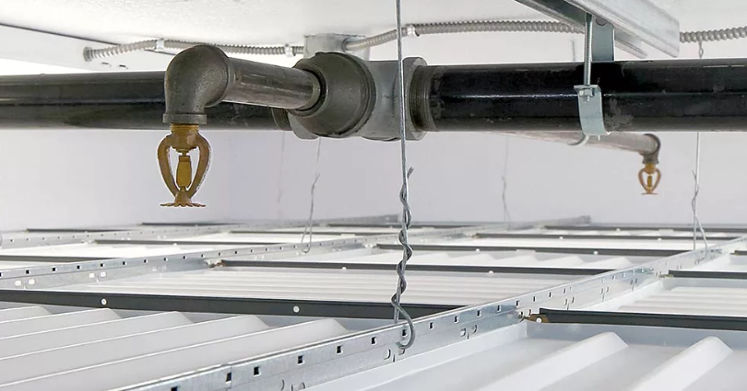
Maryland SFPC
Amendment X
  Add subparagraph: 9.7.1.1.1 For new ceiling installations, drop-out ceilings as referenced in NFPA 13, 9.3.1.1 and NFPA 13R, 6.15, shall be prohibited
  Drop-out ceilings prohibited in NFPA 13R for consistency with prohibition in NFPA 13
NFPA 101
Notes:
This one is straightforward
Drop-out ceilings have been prohibited for a long time, and this picks up the prohibition in NFPA 13R
It doesn’t make a lot of sense to allow them in building using 13R and not 13
So we picked this up to be consistent

Slide 11
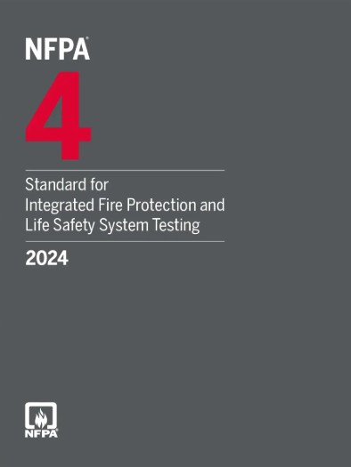
Maryland SFPC
Amendment Z
  9.11.4.2* NFPA 4 Testing. Where required by the AHJ, 9.3.5 or Chapters 11 through 43, the following integrated fire protection and life safety systems shall be tested in accordance with 9.11.4.21 through 9.11.4.2.2:
    (1) Integrated fire protection and life safety systems in high-rise buildings
    (2) Integrated fire protection and life safety systems that include a
    smoke control system
  Gives the AHJ authority regarding integrated testing
NFPA 101
Notes:
Another amendment in Chapter 9, this is in regard to integrated testing per NFPA 4 in high-rise buildings and buildings having a smoke control system
These provisions were added in the 2018 edition
In this cycle, the committee added the AHJ language
Note that this is an “or” statement, so integrated systems may be required wherever the AHJ deems fit

Slide 12

Maryland SFPC
Amendment AA
  9.13.1 System Verification. Where required by the AHJ and another section of this Code, special inspections and tests shall be performed to verify the operation of the fire protection system in its final condition for acceptance by the AHJ.
    Intent is to grant the AHJ the option to require testing
NFPA 101
Notes:
Still in Chapter 9, this amendment is for special inspection requirements
Right now, NFPA 101 requires special inspections only for smoke control systems
Note that this is an “and” statement, so both the code and the AHJ are needed to require special inspections

Slide 13
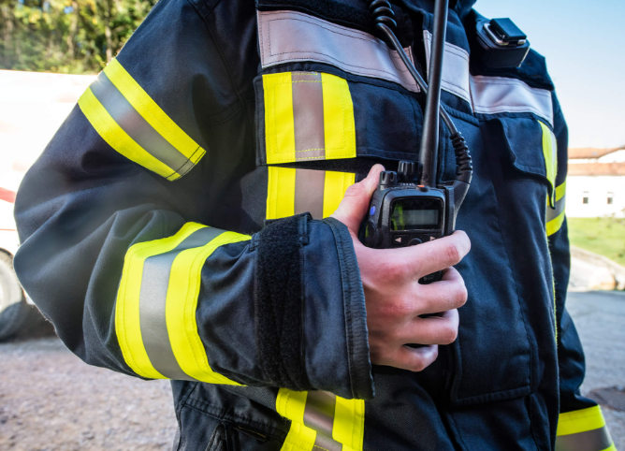
Maryland SFPC
Amendment BB
  9.15.1 Where provided, in-building emergency responder communications enhancement systems shall comply with the design, installation, testing, inspection, and maintenance requirements of NFPA 1225 and the AHJ.
  9.15.2 In new buildings, the minimum in-building emergency responder communications enhancement system signal strength shall be in accordance with NFPA 1225 and the AHJ.
  Both amendments give the AHJ greater authority with regard to ERCES
NFPA 101
Notes:
Amendment BB is for ERCES in Chapter 9
Again we have an amendment granting the AHJ additional authority
This was added because there were local authorities that have needs that differ from NFPA 1225 so this language is added to give them that authority

Slide 14
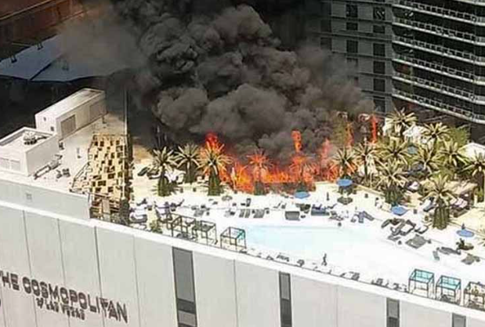
Maryland SFPC
Amendment CC
  10.4.1* General. Unless otherwise permitted by the AHJ, outdoor furniture placed under a combustible exterior projection shall comply with Section 10.4.
  10.5.1* General. Unless otherwise permitted by the AHJ, combustible artificial decorative vegetation placed outdoors, within 5 ft of a building, on a roof of a building, or under an overhang shall comply with Section 10.5.
  Both changes give the AHJ discretion to apply the requirements
NFPA 101
Notes:
Moving on to Chapter 10 on Interior Finish and Contents we have an amendment related to outdoor furniture
There are a host of requirements for furniture and artificial vegetation
This was all new to the 2021 edition
I believe that this was the response to the 2015 fire at the cosmopolitan in las vegas
This fire caused $2M in damage and sent one person to the hospital
These requirements definitely have their place but there might be situations where it is not as significant of an issue

Slide 15
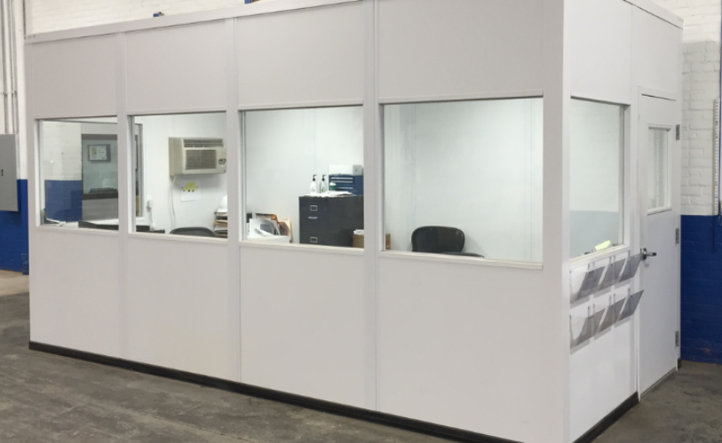
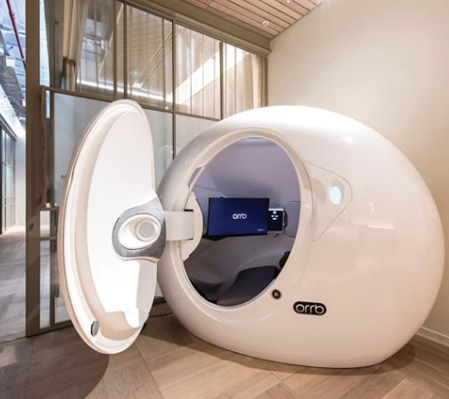
Maryland SFPC
Amendment DD
  10.7.1.1 Newly installed modular rooms and sleep pods provided in indoor locations shall comply with 10.7.1 through 10.7.5.2 and be approved by the AHJ.
    Again, gives the AHJ discretion
  Bolsters Section 10.7.5.1 which allows modular rooms and sleep pods only in approved locations
NFPA 101
Notes:
Staying in Chapter 10, modular rooms and sleep pods are new to the 2024 edition
This is a new architectural concept. Sleep pods can now be found in libraries, offices, and other places where people do not normally sleep.
Anyone seeing these?
Discomfort on the committee about how and where these might used and how many could be proposed
Where they are allowed, there are maximum dimensions, interior finish requirements, and they are required to be UL listed
The listing criteria brings in requirement for fire protection and detection, ceiling types, and emergency lighting
That’s all great but the committee also wanted a full proof veto on the concept to prohibit them when they felt necessary

Slide 16
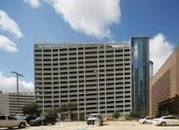
Maryland SFPC
Amendment EE
  11.8.3.1 High-rise buildings shall be protected throughout by an approved, supervised automatic sprinkler system in accordance with Section 9.7. A sprinkler control valve and a waterflow device shall be provided for each floor. High-rise buildings do not include a structure or building used exclusively for open-air parking.
  Adds a sentence to indicate that open-air parking structures are not required to comply with the requirements of this Section. This correlates this requirement for the definition and protection in open-air parking garages stated in the Maryland Public Safety Article.
NFPA 101
Notes:
Moving on to Chapter 11, Special Structures and High-rise Buildings
A couple of sections amended
These just delete the words “fire department” and add “AHJ”
8.6.2 seems a little strange to me
I’m not sure that it’s getting any use
I can’t think of a situation where the separation requirement would be waived for a fire command center

Slide 17
Maryland SFPC
Amendment FF
  11.8.6.1 The location, design, content, and fire department access of the emergency command center shall be approved by the fire department AHJ.
  11.8.6.2 The emergency command center shall be separated from the remainder of the building by a fire barrier having a fire resistance rating of not less than 1 hour, unless otherwise approved by the fire department AHJ.
  Both amendments clarify situations where other agencies are the AHJ
NFPA 101
Notes:
Moving on to Chapter 11, Special Structures and High-rise Buildings
A couple of sections amended
These just delete the words “fire department” and add “AHJ”
8.6.2 seems a little strange to me
I’m not sure that it’s getting any use
I can’t think of a situation where the separation requirement would be waived for a fire command center

Slide 18
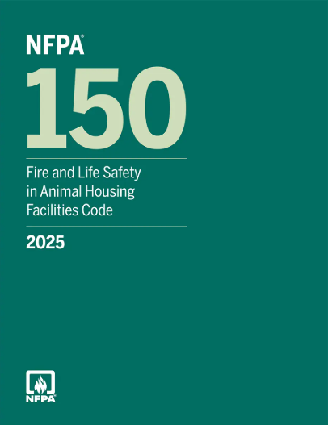
Maryland SFPC
Amendment HH
  Delete Section 11.12 Animal Housing Facilities
  Consistent with removing NFPA 150 from Chapter 2
NFPA 101
Notes:
This one is pretty straightforward
We deleted Animal Housing and Facilities from Chapter 2
Here we’re picking up the reference in Chapter 11 and deleting that as well

Slide 19
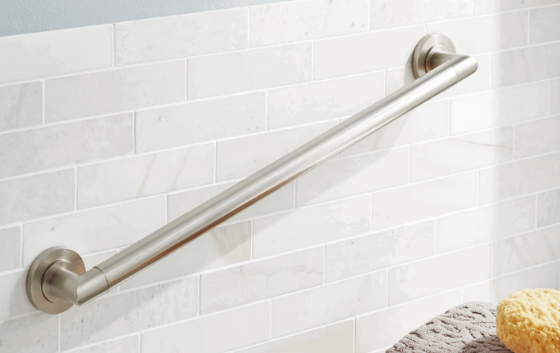
Maryland SFPC
Amendment II
  Delete Paragraphs 12.2.1.2, 14.2.1.5, 16.2.1.1, 28.2.1.4, 30.2.1.3, 32.2.2.7, 36.2.1.6, 38.2.1.5, 40.2.1.3, 42.2.1.3, Subparagraphs 16.6.2.1.2, 32.3.2.1.3, and Subsection 26.2.4.
NFPA 101
Notes:
Here we have Amendment double I deleting requirements for grab bars
Man- the grab bar people were prolific
They got them in everywhere- assembly, educational, day care, hotels, apartments, residential board and care, lodging and rooming, mercantile, business, storage- even industrial
Interestingly, they missed on the health care committee
But the intent here was to delete them wherever they occur
Here, we have an example of a paragraph that was deleted

Slide 20
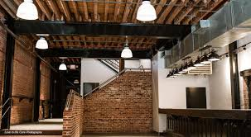
Maryland SFPC
Amendment JJ
  Amend Paragraphs 12.3.4.1 and 13.3.4.1 to add the following;
  Not less than two separate exits shall be provided on every story.
  Not less than two separate exits shall be accessible from every part or every story.
  12.3.4.1 The number of means of egress shall be in accordance with Section 7.4, other than exits for fenced outdoor assembly occupancies in accordance with 12.2.4.4.
NFPA 101
Notes:
Here we have Amendment double I deleting requirements for grab bars
Man- the grab bar people were prolific
They got them in everywhere- assembly, educational, day care, hotels, apartments, residential board and care, lodging and rooming, mercantile, business, storage- even industrial
Interestingly, they missed on the health care committee
But the intent here was to delete them wherever they occur
Here, we have an example of a paragraph that was deleted

Slide 21
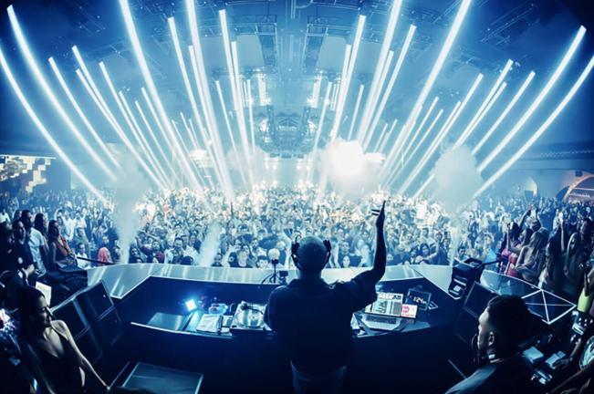

Maryland SFPC
Amendment KK
  The following assembly occupancies having an occupant load of 100 or more persons, or 5,000 or more square feet in area, or located on a floor other than the level of exit discharge shall be protected throughout by an approved, electrically supervised automatic sprinkler system in accordance with 9.7.1.1(1) and 9.7.2.
    One of the more significant amendments
    Raises the threshold from 50 persons to 100
    Brings sprinkler requirements in line with IBC, Group A-2
NFPA 101
Notes:
Moving on to Chapter 12, this is my personal favorite amendment
Finally, we do not have to define “nightclub”
I probably don’t need to remind you but the 2018 edition included: dance halls, discotheques, nightclubs, and occupancies w/ festival seating
That created the need to distinguish between a restaurant and bar, and of course a nightclub
Then there was an emphasis on “live entertainment”
A comedy club was a nightclub, but no one thought that the requirement was meant to apply to a guy w/ a guitar in a coffee shop
So finally the 2021 edition of NFPA 101 added “bar” and “restaurant” to the list which essentially solved the problem
Unfortunately, that happened to be the first edition of NFPA 101 that the State of Maryland failed to adopt
Note that without the amendment sprinklers in these types of occupancies would be triggered at 50 persons, because 50 persons is the threshold for the assembly occupancy classification
If you are a small restaurant having 50 or more persons, you are subject to Chapter 12, and thus 12.3.5.1
With the amendment it raises the threshold to 100 persons and matches the requirements of the IBC that most folks tend to expect
I think that overall this is a big win on this issue

Slide 22
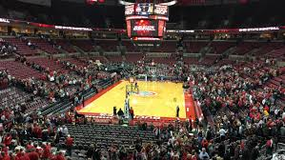
Maryland SFPC
Amendment LL
  12.7.7.3* In the following assembly occupancies, an audible announcement shall be made, or a projected image shall be shown, within 10 minutes prior to the start of each program that notifies occupants of the location of the exits to be used in case of a fire or other emergency: theaters, motion picture theaters, auditoriums, etc.
    Establishes a time requirement near to the start of the program
    Ensures that exits are identified when most viewers are present
NFPA 101
Notes:
Staying in Chapter 12
LL is for exit announcements in assembly occupancies
Prevents the venue from making the announcements before everyone gets there and gets seated
With the amendment you have to wait until 10 minutes before the start of the program to play the announcement on exit

Slide 23
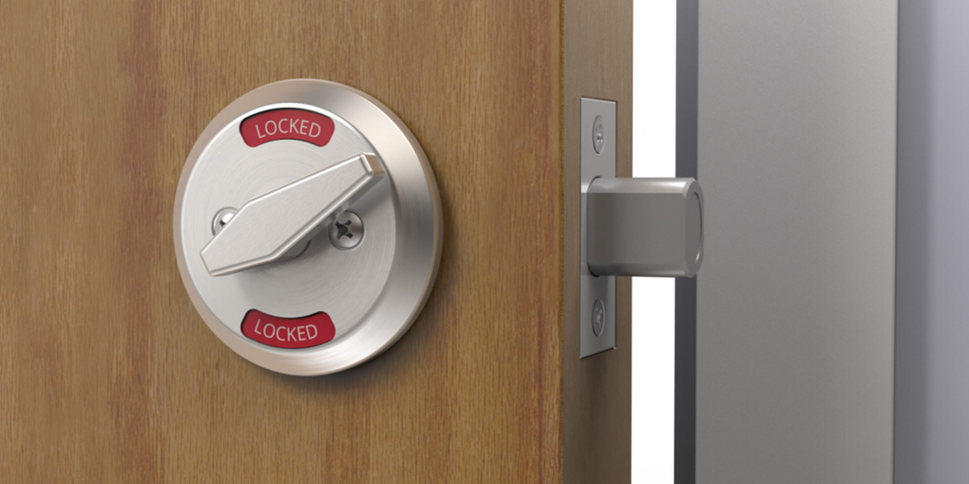
Maryland SFPC
Amendment NN
  15.2.2.2.4.1(3)* Two releasing motions shall be permitted where approved by the AHJ provided that releasing does not require simultaneous operations, the locking device is of a type that is readily distinguishable as locked, and provided the door is not equipped with panic hardware or fire exit hardware.
  17.2.2.2.6.1(3)* Two releasing motions shall be permitted where approved by the AHJ provided that releasing does not require simultaneous operations, the locking device is of a type that is readily distinguishable as locked, and provided the door is not equipped with panic hardware or fire exit hardware.
  Existing Educational and Existing Day-Care Occupancies
NFPA 101
Notes:
These are amendments to the Existing Educational and Existing Day Care occupancies
Simply adds the readily distinguishable to the requirement where locks have two releasing mechanisms
So here you can see an example of a lock that meets the requirements

Slide 24
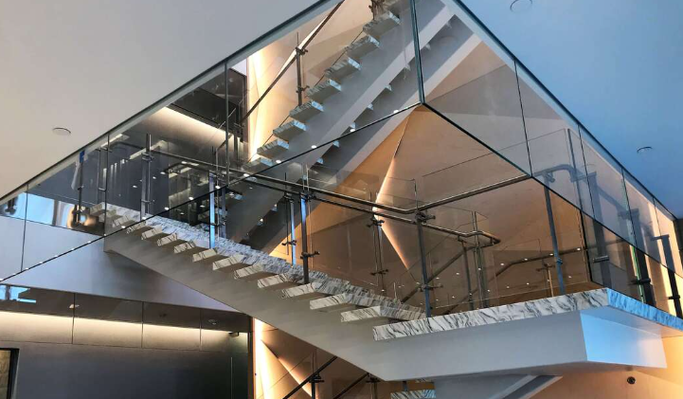
Maryland SFPC
Amendment OO
  15.2.4.2 Not less than two separate exits shall be in accordance with the following criteria:
    (1) They shall be provided on every story unless otherwise permitted by 15.2.4.2(3).
    (2) They shall be accessible from every part of every story and mezzanine; however, exit access travel shall be permitted to be common for the distance permitted as common path of travel by 15.2.5.2
    (3) Unenclosed stairs shall be permitted in accordance with 15.3.1.3.
NFPA 101
Notes:
Amendment OO in the Existing Education chapter
Section 15.3.1.3 gives a few scenarios where stair enclosures would not be required
The main one being where a stair connects only two floors, other than a basement– you can have an unprotected opening
This was new to the 2021 edition and not in the 2018 code
The committee was not comfortable with allowing unenclosed stairs to be used as an exit in any situation in an Educational occupancy
So they deleted this whole concept
Two exits are required on every story

Slide 25
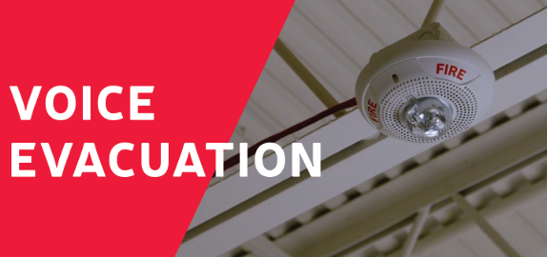
Maryland SFPC
Amendment PP
  15.3.4.3.1.2* When an existing fire alarm control unit or system in a building is replaced, the occupant notification required by 15.3.4.3.1.1 shall use an emergency voice/alarm communication system in accordance with 9.6.3 where the building has an occupant load of more than 100.
    Allows control unit to be replaced without triggering voice requirement
NFPA 101
Notes:
Staying in the Existing Educational chapter
This section was reserved in the 2018 and 2021 editions and made it into the code in 2024
The NFPA language requires you to upgrade the system to voice whether you are replacing the whole system or just the panel
With this amendment we allow control units to be replaced w/o voice
But if you start replacing initiating and notification devices, it’s time to upgrade

Slide 26
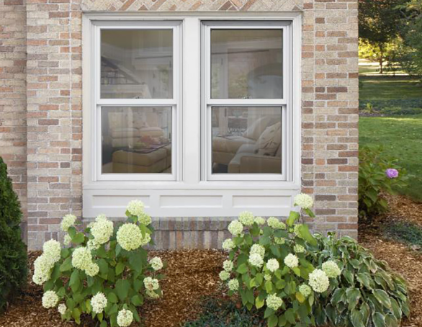
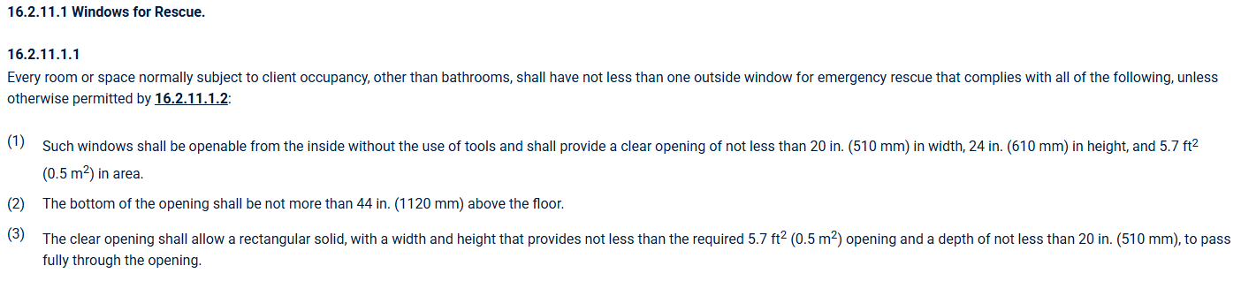
Maryland SFPC
Amendment RR
  Add the following subparagraph: (4) For grade floor windows the minimum net clear opening shall be permitted to be 5.0 square feet
NFPA 101
Notes:
This is for Chapter 16, New Cay Care
This is in regard to windows for rescue in day care occupancies
Clear opening is required by 101 to be 5.7 sf – LASER – SHOW ADDED SECTION
Amendment slightly reduces clear opening for grade floor windows
This was done for consistency w/ the IBC

Slide 27
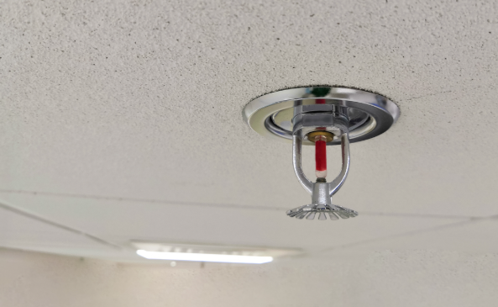
Maryland SFPC
Amendment SS
  Add the following to paragraph 16.3.5.1
  Sprinkler protection is not required if all of the following conditions are met:
    (1) The total number of occupants in the occupancy in which the day care center is located is not more than 300 persons;
    (2) All rooms used for day care are located on the level of exit discharge;
    (3) All rooms used for day care have at least one exterior exit door at grade level, and
    (4) The occupancy in which the day care center is located does not exceed 12,000 square feet in area.
NFPA 101
Notes:
Another amendment in New Day Care
Section 16.3.5.1 now requires all new day care occupancies to be provided with sprinkler protection
This was new to the 2021 edition
The amendment gives some leeway to new day care occupancies meeting these criteria
Sort of a mix of the IBC Group E and Group I sprinkler exceptions
It may apply for many existing non-sprinklered churches that begin offering day care services

Slide 28
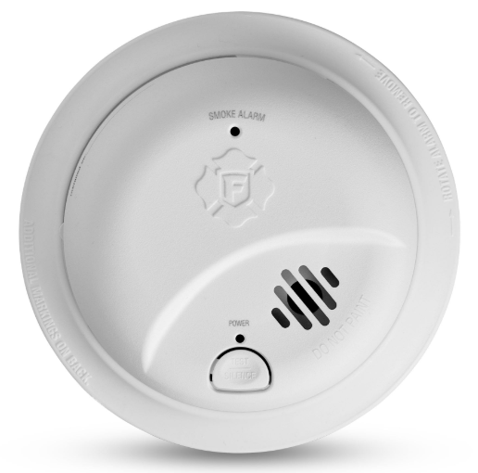
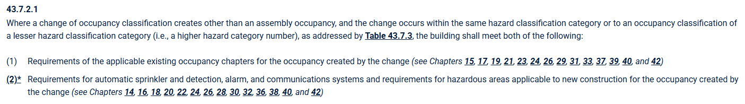
Maryland SFPC
Amendment AAA
  Replace “Reserved” paragraph with:
  16.6.3.4.5 For compliance with Paragraph 43.7.2.1(2), approved battery-powered smoke alarms, rather than house electrical service-powered smoke alarms required by 16.6.3.4.4, shall be permitted where the facility has testing, maintenance, and smoke alarm replacement programs that ensure reliability of power to the smoke alarms.
NFPA 101
Notes:
Staying in Chapter 16 we have triple A
Replaces a reserved section
In regard to day care homes where there has been a change in occupancy classification
Have to comply with new chapter for fire alarm
Amendment permits battery-operated smoke alarms

Slide 29
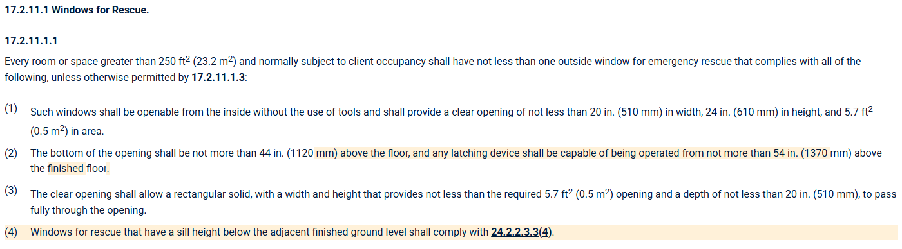
Maryland SFPC
Amendment BBB
  Add the following subparagraph: (5) For grade floor windows the minimum net clear opening shall be permitted to be 5.0 square feet
NFPA 101
Notes:
This is for the Existing Day Care chapter
This is in regard to windows for rescue in day care occupancies – the same as we discussed in Ch. 16
Clear opening is required by 101 to be 5.7 sf
Amendment slightly reduces clear opening for grade floor windows to 5.0 sf
Also provides some consistency with the building code

Slide 30
Maryland SFPC
Amendment CCC
  Amend Paragraphs 17.6.2.1, 28.2.1.2, 29.2.1.2, 30.2.1.2, 31.2.1.2 and Subparagraphs 16.6.2.1.1, 16.6.2.4.1, 16.6.2.4.2, 17.6.2.4.2, and 33.3.2.1.2 to add the following sentence:
    The provisions of Section 24.2.8 shall not apply.
  Deletes grab bar requirements
NFPA 101
Notes:
Intent was to remove grab bar requirements wherever they occurred and get fire officials out of the grab bar business
These were inserted into means of egress and means of escape provisions
The committee removed them

Slide 31
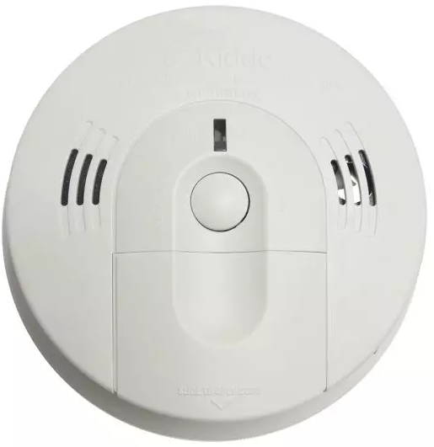
Maryland SFPC
Amendment EEE
  Add the following to Section 19.3
  19.3.4.6 Carbon Monoxide Detection.
  19.3.4.6.1 Carbon monoxide detection, where required by 19.3.4.6.2, shall be in accordance with Section 9.12.
  19.3.4.6.2 Carbon monoxide detection shall be provided in the following locations:
    (1) Carbon monoxide detectors shall be installed on the ceilings of rooms containing permanently installed fuel-burning appliances, including fireplaces.
    (2) Carbon monoxide detectors shall be installed within 36 inches of the first supply air register from a permanently installed, fuel-burning HVAC system.
NFPA 101
Notes:
Triple E adds carbon monoxide requirements to Existing Health Care Occupancies
Copies requirements from Ch. 18 which are new to the 2024 edition
Gives us CO requirement when we have fuel-burning appliances

Slide 32
Maryland SFPC
Amendment FFF
  Add the following to Section 21.3
  21.3.4.5 Carbon Monoxide Detection.
  21.3.4.5.1 Carbon monoxide detection, where required by 19.3.4.6.2, shall be in accordance with Section 9.12.
  21.3.4.5.2 Carbon monoxide detection shall be provided in the following locations:
    (1) Carbon monoxide detectors shall be installed on the ceilings of rooms containing permanently installed fuel-burning appliances, including fireplaces.
    (2) Carbon monoxide detectors shall be installed within 36 inches of the first supply air register from a permanently installed, fuel-burning HVAC system.
NFPA 101
Notes:
Same thing here, this time in the Existing Ambulatory Health Care Occupancies
It also copies requirements from Ch. 20 which are new the 2024 edition
Again, this gives us a CO requirement where we have fuel-burning appliances present

Slide 33
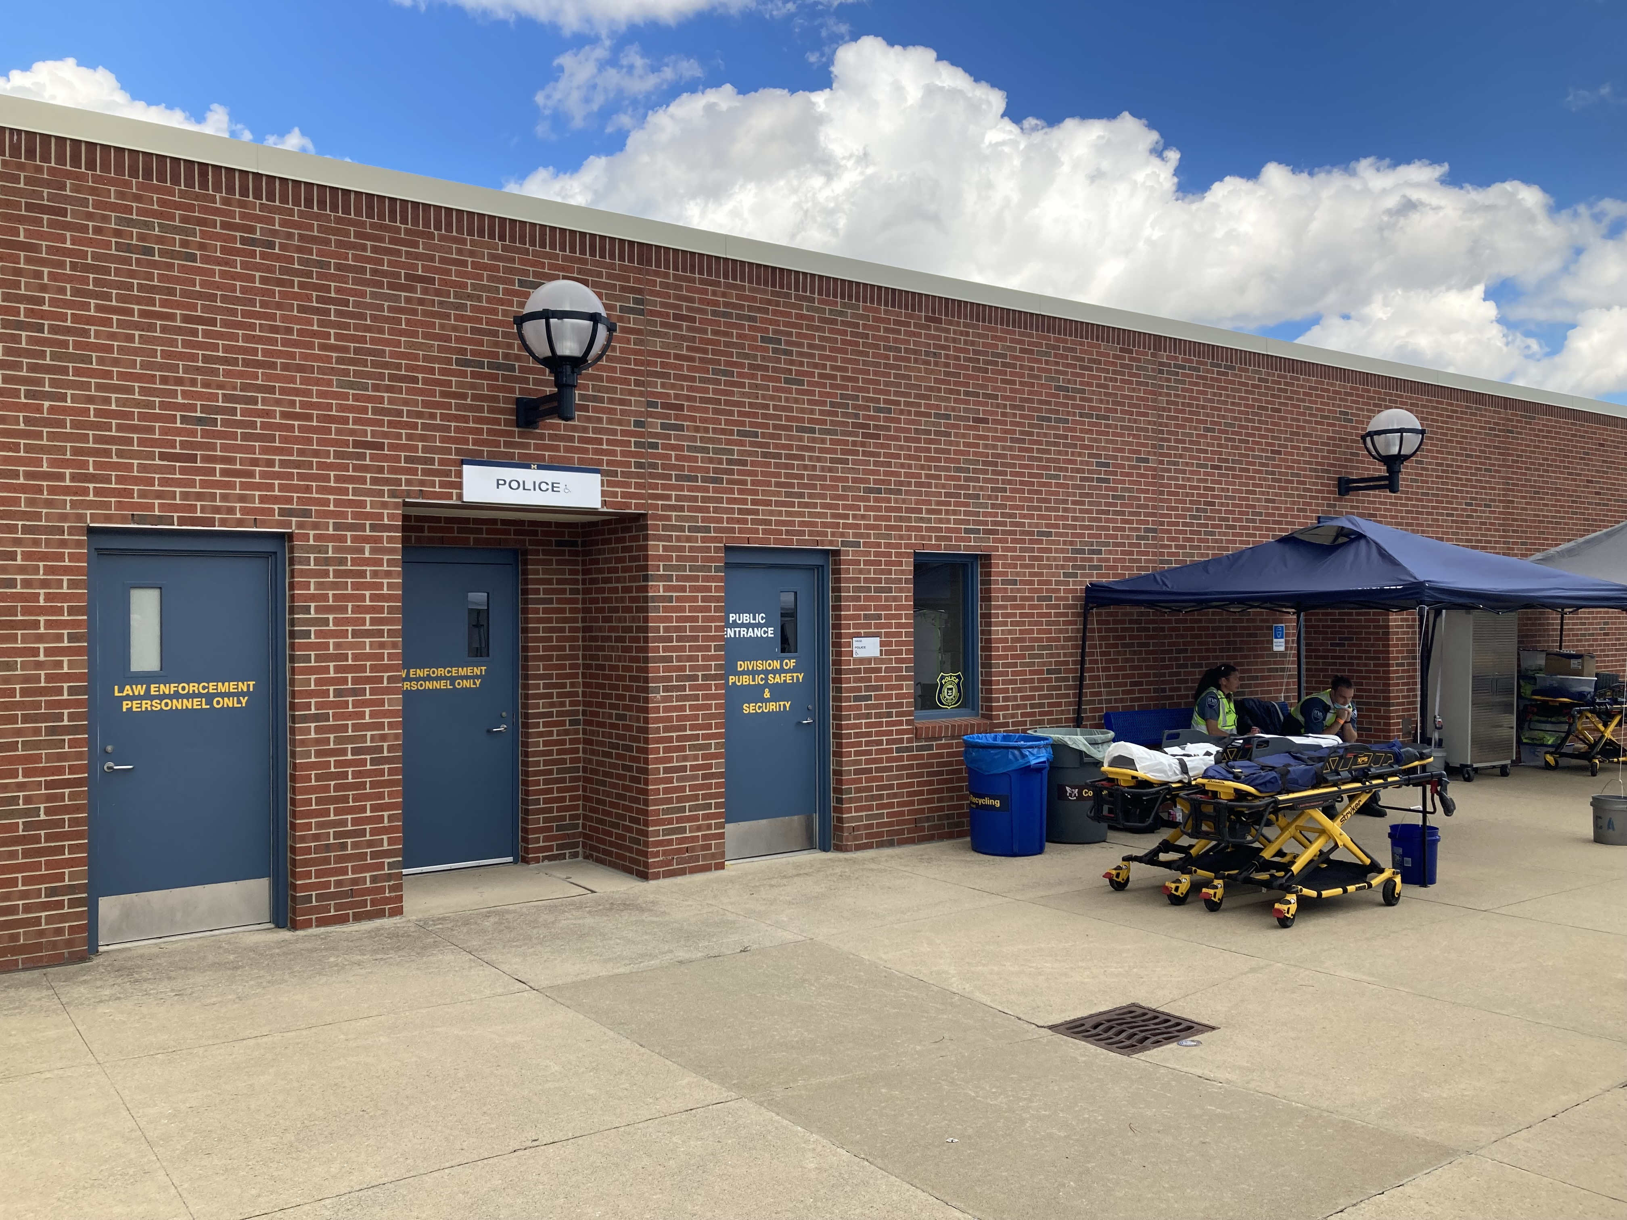
Maryland SFPC
Amendment GGG
  Add the following Subparagraph to 22.4.6.2:
    22.4.6.2.5 Automatic sprinkler protection shall be installed throughout the building in accordance with 9.7.1.1.
    No longer amend 22/23.4.6.1.3 to prohibit use of 22/23.4.6.1.5
  Alternate Provisions added back as an option for lockups in occupancies other than detention and correction where the building is fully sprinklered
NFPA 101
Notes:
Triple G is an amendment in the New Detention chapter
This is about lockups that typically occur in other occupancies
For example, a sheriff’s office which is predominantly a business occupancy
For a long time, the alternate provisions in Chapter 22 and 23 were deleted by the Maryland amendments (LASER POINTER TO 22.4.6.1.5)
No one could remember exactly why
The result of deleting this was lockups had to meet 2-minute release times
Basically, you couldn’t have a lockup if you could not guarantee a 2 minute release at all time
In this cycle it was decided to allow the alternate provisions with an important caveat: only in sprinklered buildings
Should be noted that lockup is also required to be provided with complete smoke detection per alternate provisions

Slide 34
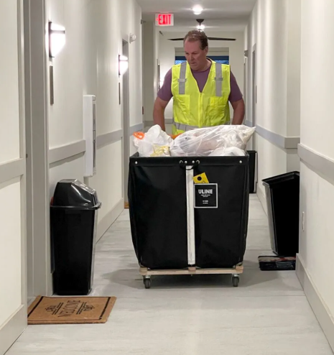
Maryland SFPC
Amendment KKK
  Delete Subsection 30.7.5 and 31.7.5
    Provisions for valet trash collection services removed
NFPA 101
Notes:
On to the Apartments chapters 30 and 31
These sections provide provisions for how to do valet trash: container sizes and construction, time limits, etc.
Valet trash is prohibited back in the amendment to Chapter 7 so none of these provisions on how to do valet trash are needed
This was another much needed amendment that was delayed by not adopting the 2021 edition

Slide 35
Maryland SFPC
Amendment LLL
  31.3.5.9.1* All high-rise buildings, other than those meeting 31.3.5.9.2 or 31.3.5.9.3, shall be protected throughout by an approved, supervised, automatic sprinkler system in accordance with 31.3.5.2 by January 1, 2033 within 12 years of the date of the original violation notice issued by the fire authority having jurisdiction.
    Every dwelling unit has exterior exit access per Ch. 7
      Exterior balconies and similar that are 50% open and protected
    Buildings with previously approved and implemented engineered life safety system
  AHJ to issue violation and provide notice
  Owner shall respond within 180 days with intent to comply
  Building to be protected within 12 years of original violation notice
NFPA 101
Notes:
So here we have triple L in the Existing Apartments chapter
As you can see the 2033 date was deleted
And language is added to reference back to the date of the violation
The first exception is for buildings having open balconies for exit access
There are some of these in Ocean City
The second exception is for buildings with previously approved engineered systems
Otherwise, the building is to be protected within 12 years of a violation notice

Slide 36
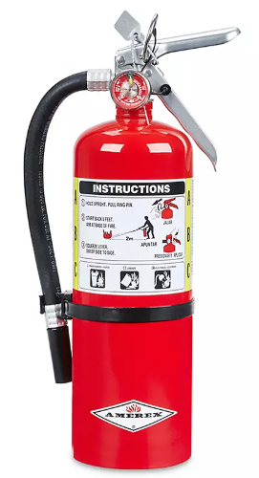
Maryland SFPC
Amendment OOO
  Amend Paragraphs 36.3.5.3, 37.3.5.3, 38.3.5.2, and 39.3.5 to replace “portable” with “Unless otherwise permitted by the AHJ, portable”
    36.3.5.3 Unless otherwise permitted by the AHJ, portable fire extinguishers shall be provided in all mercantile occupancies in accordance with Section 9.9.
    Gives AHJ leeway on whether to require extinguishers in mercantile and business occupancies
NFPA 101
Notes:
And finally for our last new amendment to NFPA 101
Triple O is for Business and Mercantile chapters, we changed four paragraphs
LASER to 36.3.5.3 – here is an example of a paragraph with the replaced language
This gives the AHJ authority on whether to enforce these requirements
OPTIONAL
NFPA 1, Amendment HHH which involves the fire extinguisher requirement table in NFPA 1, that amendment also gives the AHJ discretion for fire extinguisher placement

Slide 37


Maryland SFPC
Questions?
Contact: kenneth.bush@maryland.gov
NFPA 101
Notes:
Questions?
Comments?
Any problem areas with the code?
Suggestions for changes or amendments?

Slide 38
Maryland SFPC
Amendment J
  Amend Section 2.4 to delete the referenced publication NFPA 5000 Building Construction and Safety Code, 2024 edition. Wherever NFPA 5000 is referenced, other than for extracted text, substitute the building code adopted by the AHJ.
NFPA 1
Notes:
Moving on to NFPA 1
The first new one is Amendment J
This is a pickup this cycle
NFPA 5000 is also deleted from the NFPA Publications Section 2.2, which was deleted in the previous cycle
This amendment picks up the deletion in Section 2.4, References for Extracts in Mandatory Sections

Slide 39
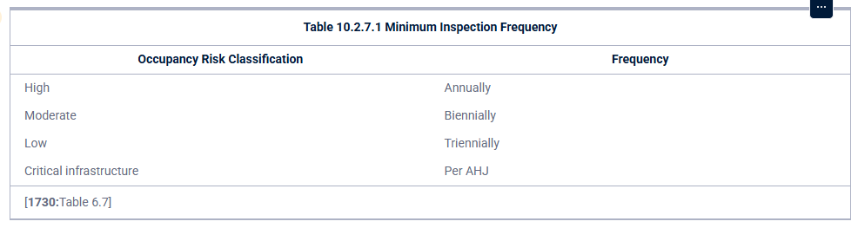
Maryland SFPC
Amendments V and W
  10.2.7.1 Fire prevention inspections shall occur on existing premises in accordance with the minimum inspections frequency schedule specified by the AHJ and Table10.2.7.1
  Add A.10.2.7.1 The frequency of fire prevention inspections of existing buildings should be based upon a risk assessment of these properties completed by the AHJ. Considerations for this assessment should include:
    Occupancy classification, hazards and special hazards
    Number, location, and mental capabilities of occupants
    Construction design and maintenance
    Fire protection features
    Fire department resources
    Resources available for inspections
NFPA 1
Notes:
This amendment address fire inspection frequency in existing buildings
Chapter 10, General Fire Safety
Last cycle this section was deleted entirely
This cycle it was decided to keep it
As you can see by the underlined text, by the AHJ, was added to give each jurisdiction some leeway over the frequency of inspections
The appendix section was added to give guidance to determine frequency

Slide 40
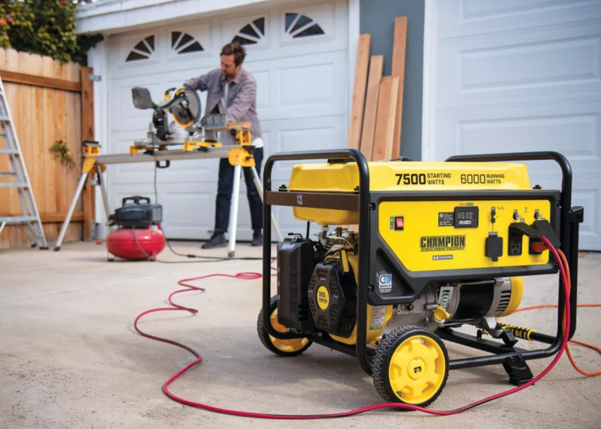
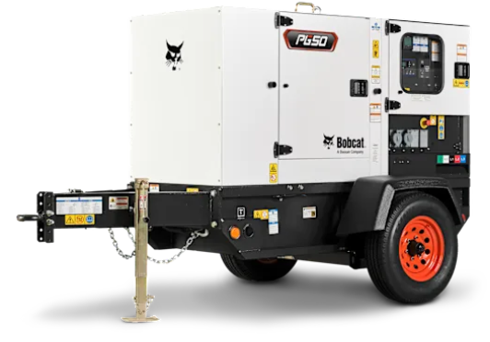
Maryland SFPC
Amendment EE
  10.15.5.1* Unless otherwise approved by the AHJ, portable and vehicle-mounted generators shall only be operated or refueled outdoors a minimum of 20 ft from any building openings, including windows, doors, and air intakes.
    Gives AHJ discretion
NFPA 1
Notes:
Here is another amendment in Chapter 10
10.15.5 is a whole new section on operation of generators that was new in the 2021 edition
The requirement gives you a minimum distance of 20 ft from openings
The amendment gives the AHJ some discretion regarding generators and distance to openings

Slide 41
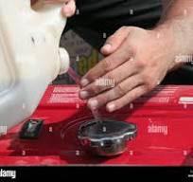
Maryland SFPC
Amendment FF
  Paragraph added to A.10.15.5.1*
  For the purposes of reducing the distances from generators to openings:
    Nature of the occupancy
    Expected duration of use of generator
    Use of certified low CO generators
    Actual available distance
    CO detectors in building
    Openness of building
    Barriers or means to deflect generator exhaust
NFPA 1
Notes:
This is an added paragraph
The first paragraph of this section tells you to take the measurement from the exhaust outlet to the opening and consider the orientation of the exhaust
The committee added some language to help determine if the distance could be reduced
You might look at things like the occupancy, is this a bedroom window in a nursing home or is it an opening to a parking garage?
You could consider mitigating features like detection or ways to deflect the exhaust

Slide 42
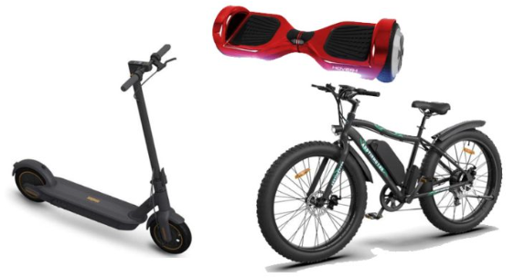
Maryland SFPC
Amendments KK, and LL
  10.21.1 Where more than five one or more powered micromobility devices will be charged inside or within 10 15 ft of a building or structure, the charging operation shall be in accordance with Section 10.21.
  LL Increases separation distance between charging and storage to 15 ft
NFPA 1
Notes:
10.21 is a new section on electric bikes, scooters, and similar equipment
Requires devices and battery packs
It requires devices to be charged using only the manufacturer’s charger or one listed in the manufacturer’s instructions
It prohibits extension cords, requires a listed receptacle, prohibits charging in corridors or exit enclosures
And it creates a separation distance from combustibles to the charger, Amendment LL increases that distance from 10 to 15 ft
This amendment strengthens the application of these provisions
Reduces the number of devices to just one and increases the separation distance

Slide 43
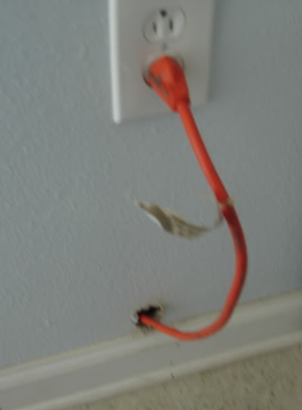
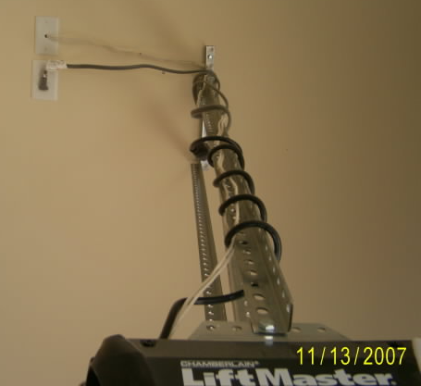
Maryland SFPC
Amendment OO
  11.1.5.6 Extension cords shall be permitted to be used on portable appliances to the nearest receptacle where receptacle spacing is in accordance with NFPA 70. Extension cords shall not be used as a substitute for permanent wiring.
NFPA 1
Notes:
The language changed in the 2021 edition
The new language appears to allow extension cords on a permanent basis
Committee chose to retain the language in the 2018 edition

Slide 44
Maryland SFPC
Amendment YY
  13.1.3.2* NFPA 4 Testing. Where required by the AHJ, 9.3.5 or Chapters 11 through 43 of NFPA 101, the following integrated fire protection and life safety systems shall be tested in accordance with 13.1.31 and 13.1.3.2.1 through 1.3.1.2.2:
    (1) Integrated fire protection and life safety systems in high-rise buildings
    (2) Integrated fire protection and life safety systems that include a smoke control system
NFPA 1
Notes:
This is another amendment that gives the AHJ discretion
These are “or” statements, so this gives the AHJ authority to require integrated testing wherever they feel it is necessary

Slide 45
Maryland SFPC
Amendment ZZ
  Add the following Subparagraph to 13.3.1.2
  13.3.1.2.1 For new ceiling installations, drop-out ceilings as referenced in NFPA 13, Subsection 9.3.1.1 and NFPA 13R, Section 6.15, shall be prohibited.
NFPA 1
Notes:
This is just picking up the drop-out ceiling prohibition in NFPA 13R

Slide 46
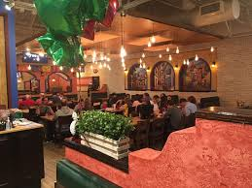
Maryland SFPC
Amendment AAA
  13.3.2.5.1 The following assembly occupancies having an occupant load of 100 or more persons, or 5,000 or more square feet in area, or located on a floor other than the level of exit discharge shall be protected throughout by an approved, electrically supervised automatic sprinkler system in accordance with 9.7.1.1(1) and 9.7.2.
    One of the more significant amendments
    Raises the threshold from 50 persons to 100
    Brings sprinkler requirements in line with IBC, Group A-2
NFPA 1
Notes:
Back to my favorite amendment
This is the same change that was made in 101

Slide 47
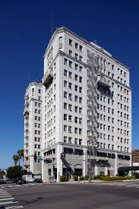
Maryland SFPC
Amendment BBB – High-Rise Buildings Sprinkler Protection
  13.3.2.24.2* Existing high-rise building, other than those meeting 13.3.2.24.1 or 13.3.24.2.2, shall be protected throughout by an approved automatic sprinkler system in accordance with this chapter and 13.3.2.24.2.3 through 13.3.2.24.2.5.
  Existing high-rise buildings shall be protected except:
    Every dwelling unit has exterior exit access per Ch. 7
      Exterior balconies and similar that are 50% open and protected
    Buildings with previously approved and implemented engineered life safety system
  AHJ to provide notice
  Building to be protected within 12 years of original violation notice
  Public Disclosure Signage
NFPA 1
Notes:
BBB changes the sprinkler requirements for existing high-rise buildings
This is all similar to what we discussed in the amendment in NFPA 101

Slide 48

Maryland SFPC
Amendment CCC
  A13.3.2.24.2.3 in the appendix will be changed to “A13.3.2.24.2.5” and now be associated with 13.3.2.24.2.5* from BBB amendment.
    A.13.3.2.24.2.5 will now be examples of retrofit schedules.
  Fixed cross-reference errors caused by previous numbering changes
NFPA 1

Slide 49
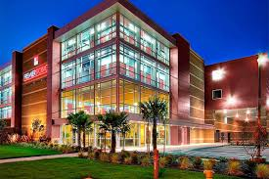
Maryland SFPC
Amendment DDD
  Delete existing wording and replace with the following:
  13.3.2.25.5 An automatic sprinkler system shall be installed throughout all mini-storage building fire areas greater than 2,500 sf and where any of the individual storage units are separated by less than a 1-hr fire resistance-rated barrier. Fire areas shall be defined by approved fire barriers having a fire-resistance rating of not less than 3 hours.
    Original language required sprinklers in all buildings greater than 2,500 sf and differs from the IBC
      Fire walls required to separate buildings
    New language specifies 3 hour fire barriers consistent w/ IBC
NFPA 1
Notes:
Amendment DDD replaces the original language for sprinkler requirements in mini storage buildings
The original language limited the building area to 2,500 sf
Designers will typically build several of these in a row and you need fire walls to separate each building
The new language allows 3 hour fire barriers instead of fire walls

Slide 50
Maryland SFPC
Amendment EEE
  Add the following to paragraph 13.3.2.27.1.1:
  Sprinkler protection is not required if all of the following conditions are met:
    (1) The total number of occupants in the occupancy in which the day care center is located is not more than 300 persons;
    (2) All rooms used for day care are located on the level of exit discharge;
    (3) All rooms used for day care have at least one exterior exit door at grade level;
    (4) The occupancy in which the day care center is located does not exceed 12,000 square feet in area.
NFPA 101
Notes:
All new day care occupancies are required to be provided with sprinkler protection per Ch. 13
This is new to the 2024 edition and catches up with what NFPA 101 did in the 2021 edition changes for day care
The amendment gives some leeway to new day care occupancies meeting these criteria
Sort of a mix of the IBC Group E and Group I sprinkler exceptions
It may apply for many existing non-sprinklered churches that begin offering day care services

Slide 51

Maryland SFPC
Amendment LLL
  Add the following to 13.7.1.7.6:
    This paragraph does not permit the omission of manual fire alarm boxes in accordance with other provisions of this Subsection unless specifically permitted by NFPA 101 Chapters 11 through 43.
      Clarifies that manual fire alarm boxes cannot be eliminated unless permitted by the occupancy chapters
NFPA 1
Notes:
Amendment triple L addresses the omission of pull stations
Some occupancy chapters like the assembly chapters allow you to omit pull stations where the building is sprinklered throughout and has a waterflow device
This section requires you to still put one pull station at a location required by the AHJ, typically a location accessible to the public
The added paragraph makes it clear that you can’t omit pull stations unless allowed by the occupancy chapter
For instance, hotels and dormitories doesn’t allow omission of pull stations
The added language prevents someone from going straight to this section and believing that one pull station is okay

Slide 52
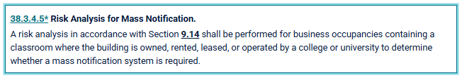
Maryland SFPC
Amendment MMM
  13.7.1.15.1* Where required by the AHJ and another section of this Code, a risk analysis for mass notification systems shall be provided in accordance with the requirements of Chapter 24 of NFPA 72.
      Provides AHJ with discretion
NFPA 1
Notes:
Amendment triple M addresses requirements for a Risk Analysis for Mass Notification Systems
This is an “and” statement
Requires both the AHJ and the occupancy chapter to trigger the requirement
For instance, NFPA 101, Chapter 38 has a new risk analysis requirement
Allows the AHJ discretion on whether they wish to push the requirement

Slide 53
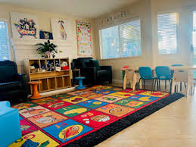
Maryland SFPC
Amendment NNN
  Add the following to 13.7.2.5.6.4:
    For compliance with NFPA 101, Paragraph 43.7.2.1(2), approved battery-powered smoke alarms, rather than house electrical service-powered smoke alarms shall be permitted where the facility has testing, maintenance, and smoke alarm replacement programs that ensure reliability of power to the smoke alarms.
NFPA 1
Notes:
This is as previously discussed for NFPA 101, AAA for day care homes
It allows battery-powered smoke alarms rather than AC powered units

Slide 54


Maryland SFPC
Amendment OOO
  13.7.2.6.6.5 Approved existing battery-powered smoke alarms rather than house electrical service-powered smoke alarms required by 13.7.2.6.6.4, shall be permitted where the facility has testing, maintenance, and battery smoke alarm replacement programs that ensure reliability of power to the smoke alarms.
NFPA 1
Notes:
OOO is for existing day care homes
Allows battery powered smoke alarms
Deletes “battery” replacement recognizing that all new smoke alarms must be ten year sealed alarms

Slide 55
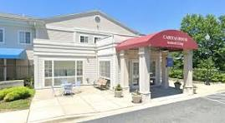

Maryland SFPC
Amendments PPP and QQQ
  13.7.2.22.8.1 All living areas, as defined in 3.3.24.5 of NFPA 101, and all corridors shall be provided with smoke detectors that comply with NFPA 72 and are arranged to initiate an alarm that is audible in all sleeping areas, as modified by 13.7.2.22.8.2 and 13.7.2.22.8.3.
    Deletes exemption for prompt and slow evacuation capability
  QQQ deletes 13.7.2.22.8.2 altogether
NFPA 1
Notes:
Triple P gets rid of a smoke detector exemption in assisted living facilities
This is something that we have done in the corresponding section of NFPA 101 for a while
It gets the AHJ out of the business of deciding the difference between impractical, prompt and slow evacuation capabilities of occupants
Those can change over time as occupants change or grow older
The text in NFPA 1 is extracted from NFPA 101, but it was thought that it should be deleted from NFPA 1 as well
That was picked up in this code update
Note that it leaves the exemption for unenclosed corridors, etc. that is shown here

Slide 56

Maryland SFPC
Amendment’s SSS
  Add the following subparagraph to 14.4.2.1:
    14.4.2.1.1 Trash or recyclable materials awaiting scheduled collection shall not be placed in exit access corridors or on egress balconies.
    Strengthens fire and evacuation pathway requirements
14.4.2.1 No furnishings, decorations, or other objects shall obstruct exits or their access thereto, egress therefrom, or visibility thereof.
NFPA 1

Slide 57

Maryland SFPC
Amendment TTT
  Add the following sentence to subparagraphs to 14.5.2.3.7 and 14.5.2.3.8:
    The locking device shall be of a type that is readily distinguishable as locked.
  Provides compliance clarity for locking mechanisms
  Improves safety and visibility
14.5.2.3.7
Two releasing motions shall be permitted for existing hardware on a door leaf serving an area having an occupant load not exceeding three, provided that releasing does not require simultaneous operations. The locking device shall be of a type that is readily distinguishable as locked.
14.5.2.3.8
Two releasing motions shall be permitted in existing educational occupancies in accordance with 15.2.2.2.4 of NFPA 101 and in existing day care occupancies in accordance with 17.2.2.2.6 of NFPA 101. The locking device shall be a type that is readily distinguishable as locked.
NFPA 1

Slide 58
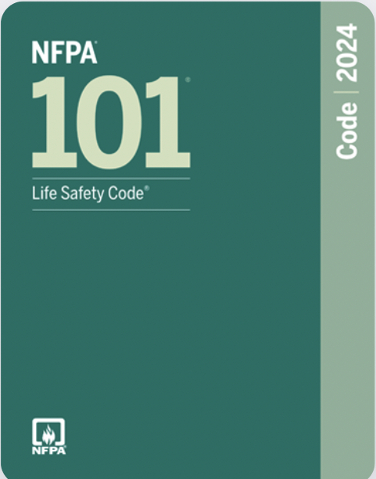
Maryland SFPC
Amendment’s UUU and VVV
  14.5.3.4.1 Where permitted in Chapters 11 through 43 by the AHJ or chapters 11 through 43 of NFPA 101, door assemblies separating the elevator lobby from the exit access required by 14.9.1.6.1 shall be permitted to be electrically locked, provided that all the following criteria are met:
  14.5.3.5.1 Where a side-hinged door assembly, a pivoted-swinging door assembly, or a balanced door assembly is required to be equipped with panic or fire exit hardware, such hardware shall meet all of the following criteria:
  Amendments improve door security, safety, and code alignment with NFPA 101
NFPA 1

Slide 59
Maryland SFPC
Amendment WWW and XXX
  14.5.3.5.4 removes “requirements” of panic hardware and reads:
Required panic hardware and fire exit hardware, in other than detention and correctional occupancies as otherwise provided in chapters 22 and 23 of NFPA 101, shall not be equipped with any locking device, set screw, or other arrangement that prevents the release of the latch when pressure is applied to the releasing device.
  XXX deletes the specifications from 14.5.8.1 and reads:
Where permanently mounted folding or moveable partitions divide a room into smaller spaces, a swinging door leaf or open doorway shall be provided as an exit access from each such space, unless otherwise specified in 14.5.8.1 or 14.5.8.2.
    Ensures safety and code clarity with hardware regarding partitions.
NFPA 1

Slide 60
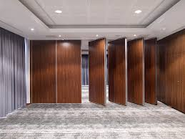

Maryland SFPC
Amendment YYY and ZZZ
  Delete the following paragraph in 14.5.8.1.
A door leaf or opening in the folding partition shall not be required, provided that all of the following criteria are met: (1),(2),(3),(4),(5).
    Deletes an exception allowing folding partitions without door openings.
  ZZZ, replace “by Chapters 11 through 43” with “by the AHJ or Chapters 11 through 43” in 14.5.10.1, which will read as follows.
14.5.10.1 Where required by Chapters 11 through 43 by the AHJ or Chapters 11 through 43 of NFPA 101, the following door assemblies shall be inspected and tested not less than annually in accordance with 14.5.10.2 through 14.5.10.7.
    Clarifies inspection responsibility
NFPA 1

Slide 61

Maryland SFPC
Amendment CCCC
  18.2.3.4 The word “shall” will be replaced with “to,” and the word “newly” will be replaced with “the AHJ shall be permitted to require newly.”
Where fire department apparatus are equipped with traffic signal preemption devices, newly the AHJ shall be permitted to require newly installed traffic signals shall to be equipped with traffic signal pre-emption.
    Clarity improvement of authority and fire department response coordination regarding traffic signal pre-emption.
NFPA 1

Slide 62

Maryland SFPC
Amendment’s DDDD and IIII
  20.1.5.8.3 The word “prior” will be changed to “within 10 minutes prior.”
In the following occupancies, an audible announcement shall be made, or a projected image shall be shown, prior within 10 minutes prior to the start of each program that notifies occupants of the location of the exits to be used in case of a fire or other emergency:
  IIII, 32.9.3.7 will change the wording of “made” and replace it with “made within 10 minutes prior to the start of each program.”
When an audience is present, an announcement shall be made made within 10 minutes prior to the start of each program notifying the audience of the following:
NFPA 1

Slide 63

Maryland SFPC
Amendment’s KKKK
  34.6 will add the following new subsection and paragraphs:
    34.6.7 standpipe systems shall be installed in all storage buildings having an area of 300,000 sq. ft. or more
    34.6.7.1 Standpipe systems shall comply with Section 13.2 and NFPA 14.
    34.6.7.2 Class I hose connections shall be provided at each of the following locations:
in each exit passageway at the entrance from the storage area into the passageway;
Within every required exit stairwell;
At other locations such that all points of the storage area floor are within 200 ft. of a hose connection, unless otherwise required by the AHJ.
    Enhances firefighting access and large-area protection
NFPA 1

Slide 64

Maryland SFPC
Amendment’s OOOO
  50.8.1 to add the following paragraphs, subparagraphs, sub-subparagraphs
      50.8.1.7 Commercial outdoor cooking operations. These requirements apply to commercial outdoor cooking operations such as those that typically take place under a canopy or tent-type structure at fairs, festivals, and carnivals. This includes, but is not limited to, deep frying, sautéing, and grilling operations.
            50.8.1.7.1 LP Gas Fuel Requirements.
              50.8.1.7.1.1 LP gas tank size shall be limited to 60 pounds. The total amount of LP gas on site shall not exceed 60 pounds for each appliance that is rated not more than 80,000 btu/hour and 120 pounds for each appliance rated more than 80,000 btu/hour.
            Improves safety and event fire protection
NFPA 1

Slide 65
Maryland SFPC
Amendment’s OOOO
  50.8.1 to add the following paragraphs, subparagraphs, sub-subparagraphs (50.8.1.7.1 continued)
      50.8.1.7.1.2 Tanks shall be maintained in good physical condition and shall have a valid hydrostatic date stamp.
      50.8.1.7.1.3 Tanks shall be secured in their upright position with a chain, strap, or other approved method that prevents the tank from tipping over.
      50.8.1.7.1.4 Tanks shall be located so that they are not accessible to the public. LP gas tanks shal be located at least 5 feet from any cooking or heating equipment or any open flame device.
      50.8.1.7.1.5 All LP gas equipment shall be properly maintained and comply with the requirements of NFPA 58.
      50.8.1.7.1.6 Regulators. Single-stage regulators may not supply equipment that is rated more than 100,000 btu/hour rating. Two-stage regulators shall be used with equipment that is rated more than 100,000 btu/hour.
NFPA 1

Slide 66

Maryland SFPC
Amendment’s OOOO
  50.8.1 to add the following paragraphs, subparagraphs, sub-subparagraphs (50.8.1.7.2 continued)
    50.8.1.7.2 General safety Requirements
      50.8.1.7.2.1 All electrical cords shall be maintained in a safe condition and shall be secured to prevent damage.
      50.8.1.7.2.2 Movable cooking equipment shall have wheels removed or shall be placed on blocks or otherwise secured to prevent movement of the appliance during operation.
      50.8.1.7.2.3 Portable fire extinguishers shall be provided in accordance with section 13.6, and shall be specifically listed for such use.
      50.8.1.8 There shall be no obstructions or impediments to immediate escape from vehicles or other mobile units used for cooking operations.
      50.8.1.9 Seating for the public shall not be located within any mobile or temporary cooking vehicle.
NFPA 1

Slide 67

Maryland SFPC
Amendment’s PPPP
  Delete subsection 50.8.3 and replace it with the following:
    50.8.3 Tent and canopy requirements
      50.8.3.1 Temporary cooking operations conducted in tents and under canopies shall comply with NFPA 102 and Chapter 25.
      50.8.3.2 All tent and canopy material shall comply with the flame resistance requirements of Section 25.2.2
      50.8.3.3 Tents or canopies where cooking equipment not protected in accordance with NFPA 96 is located shall not be occupied by the public.
      50.8.3.4 Tents or canopies where cooking equipment not protected in accordance with NFPA 96 is located shall be separated from other tents, canopies, structures, or vehicles by a minimum of 10 feet (3050 millimeters) unless otherwise approved by the AHJ.
NFPA 1

Slide 68

Maryland SFPC
Amendment’s QQQQ
  50.8.8.3.2 reads “not be transported or stored inside the vehicle” and should be replaced with “be secured in an upright position during transport and storage.” So the text will read as follows:
    Disconnected LP-Gas containers and LP-Gas cylinders for purposes other than engine fuel systems shall not be transported or stored inside the vehicle be secured in an upright position during transport and storage.
  Clarifies safe handling of disconnected LP-Gas containers.
  Enhances transport safety and cylinder stability requirements.
NFPA 1

Slide 69

Maryland SFPC
COMAR 29.06.01.16
    Visual Obscuration Systems
    Prohibits the installation and use of visual obscuration systems associated with security or burglar alarm systems.
COMAR 29.06.01.16

Slide 70
Maryland SFPC
Questions?
Contact: kenneth.bush@maryland.gov
NFPA 1
Notes:
We’re going to stop it there to leave time for questions
We covered 20 of the new amendments of NFPA 1
There’s a number of other amendments to Ch. 14, Means of Egress that I encourage you to take a look at as well as a number of others
One more that I really like is a requirement for Storage Plans in the General Storage, Ch. 34, it’s 34.1.3
The amendment is another change to give the AHJ discretion but the requirement itself is very helpful
It documents permissible commodity classes, storage arrangement, sprinkler design criteria, etc.
With that- any questions?

